Slide 1
VLC
Name :DARA SAI KUMAR
Summer Intern 2023, IIIT-Bangalore
Email:B20EC035@nitm.ac.in
SRIP-2023

Slide 2
Project
Li-Fi Data Transmission Using LED Blinking viaPSoC and Image-Capturing Camera Receiver
Connected Devices and Wearables Lab, IIIT-B

Slide 3
Abstact
-The Aim of Project is to explore Possibility of use of LED lights as a means of transmitting data via Li-Fi technology
-The data is captured by an Android smartphone camera, while the LED transmitter is implemented through PSoC-4. The camera captures the subtle changes in the state of the LED light.Images are used to determine the presence or absence of the ON/OFF condition
Agenda
-Different Methods to detect ON/OFF state of LED Image
-Auto-ML Packages for Image Classification
Connected Devices and Wearables Lab, IIIT-B

Slide 4
Different methods to detect ON/OFF of LED from Image
Connected Devices and Wearables Lab, IIIT-B

Slide 5
--When the ON/OFF of an LED is Captured in the form of an Image there are several methods that can be employed to detect the image is ON/OFF.
---Based on The Intensity of Number of Pixels Present in the image ,Machine/Human can interpret what is the present state of LED
Common Methods:
Thresholding:
Template Matching:
Edge Detection:
Histogram Analysis:
Machine Learning Algorithms:
Connected Devices and Wearables Lab, IIIT-B

Slide 6
Thresholding
Thresholding is the basic straight forward technique applied to the Captured LED Images to determine the state of the Led
By selecting an appropriate Threshold Value ,one can determine whether a pixel’s intensity corresponds to LED being ON/OFF.
Steps involved in
1.selected a threshold value:
we have chose a threshold value that will be used to separate the pixel intensities into two categories
(i.e.below threshold OFF & above threshold ON)
2.Apply the Threshold:
we apply the threshold value to compare each pixel intensity determine the state of Led
3.Generating a binary Image :
After thresholding Process we generate a binary image where pixels are represented based on their intensity which provides clear separation B/W LED ON/OFF
4.Analysis:
Based on the binary image ,one can perform the further processing like extracting specific features
Connected Devices and Wearables Lab, IIIT-B
Connected Devices and Wearables Lab, IIIT-B

Slide 7
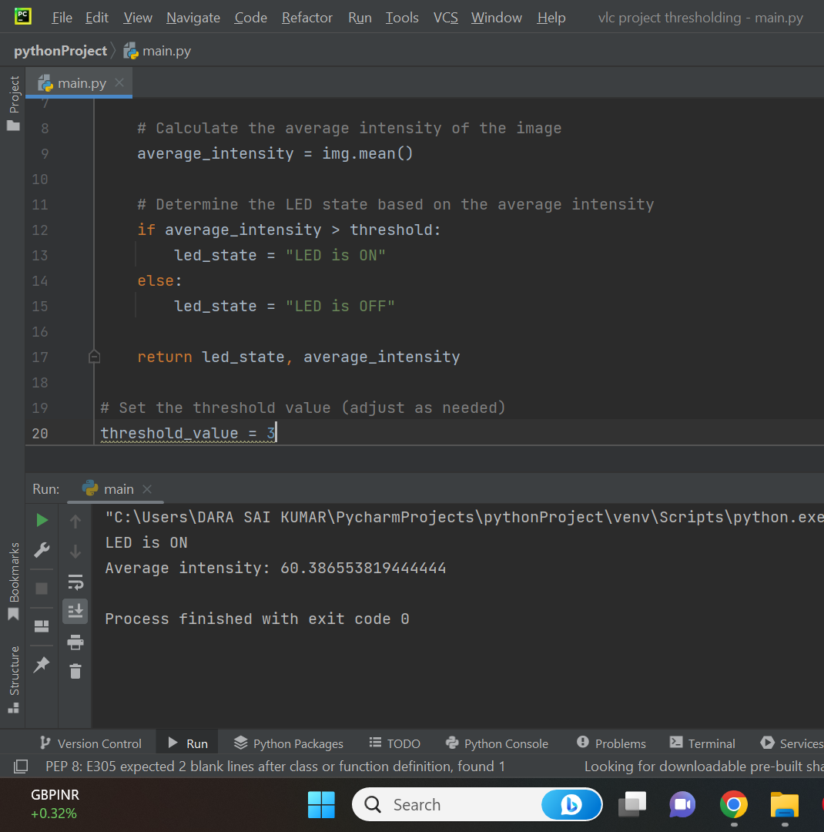
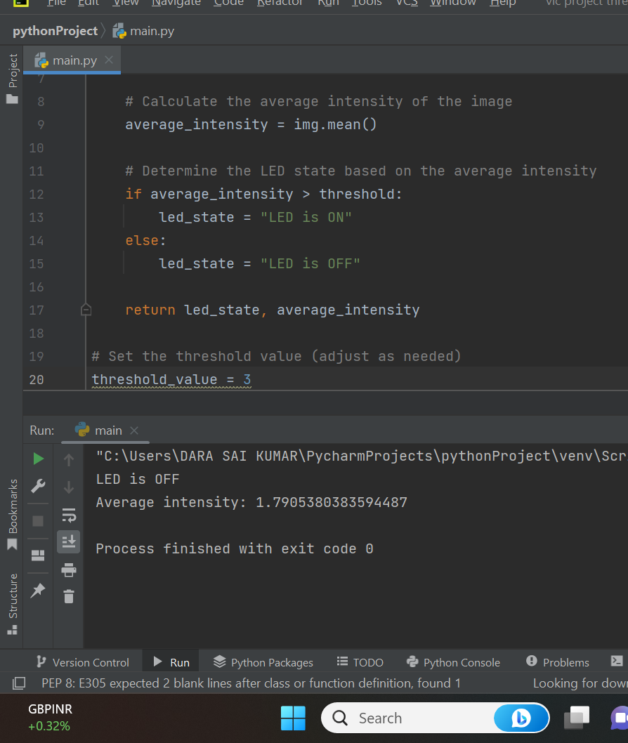


Thresholding
Connected Devices and Wearables Lab, IIIT-B
Connected Devices and Wearables Lab, IIIT-B

Slide 8

TEMPLATE MATCHING
TEMPLATE Image
TARGET IMAGE
WINDOW SLIDING
Connected Devices and Wearables Lab, IIIT-B
Connected Devices and Wearables Lab, IIIT-B

Slide 9
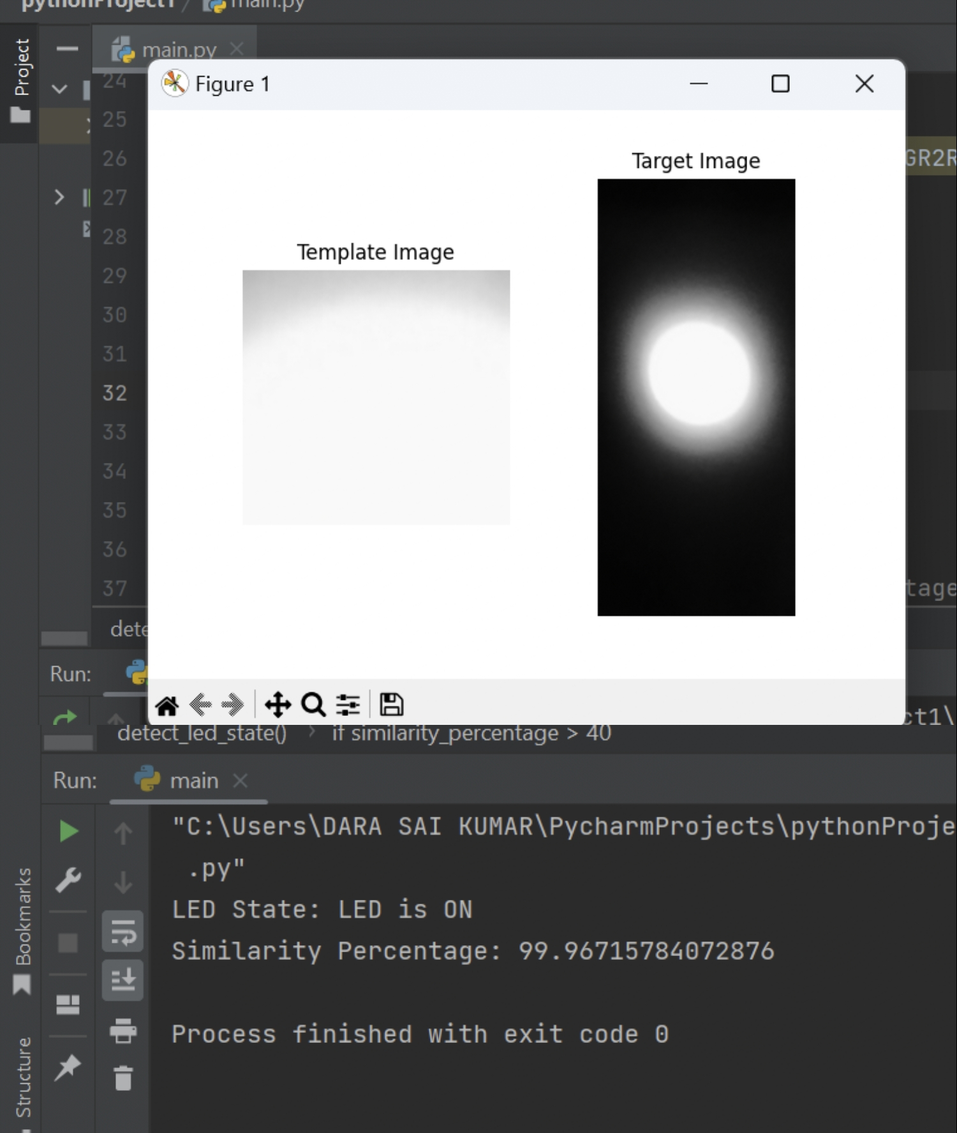
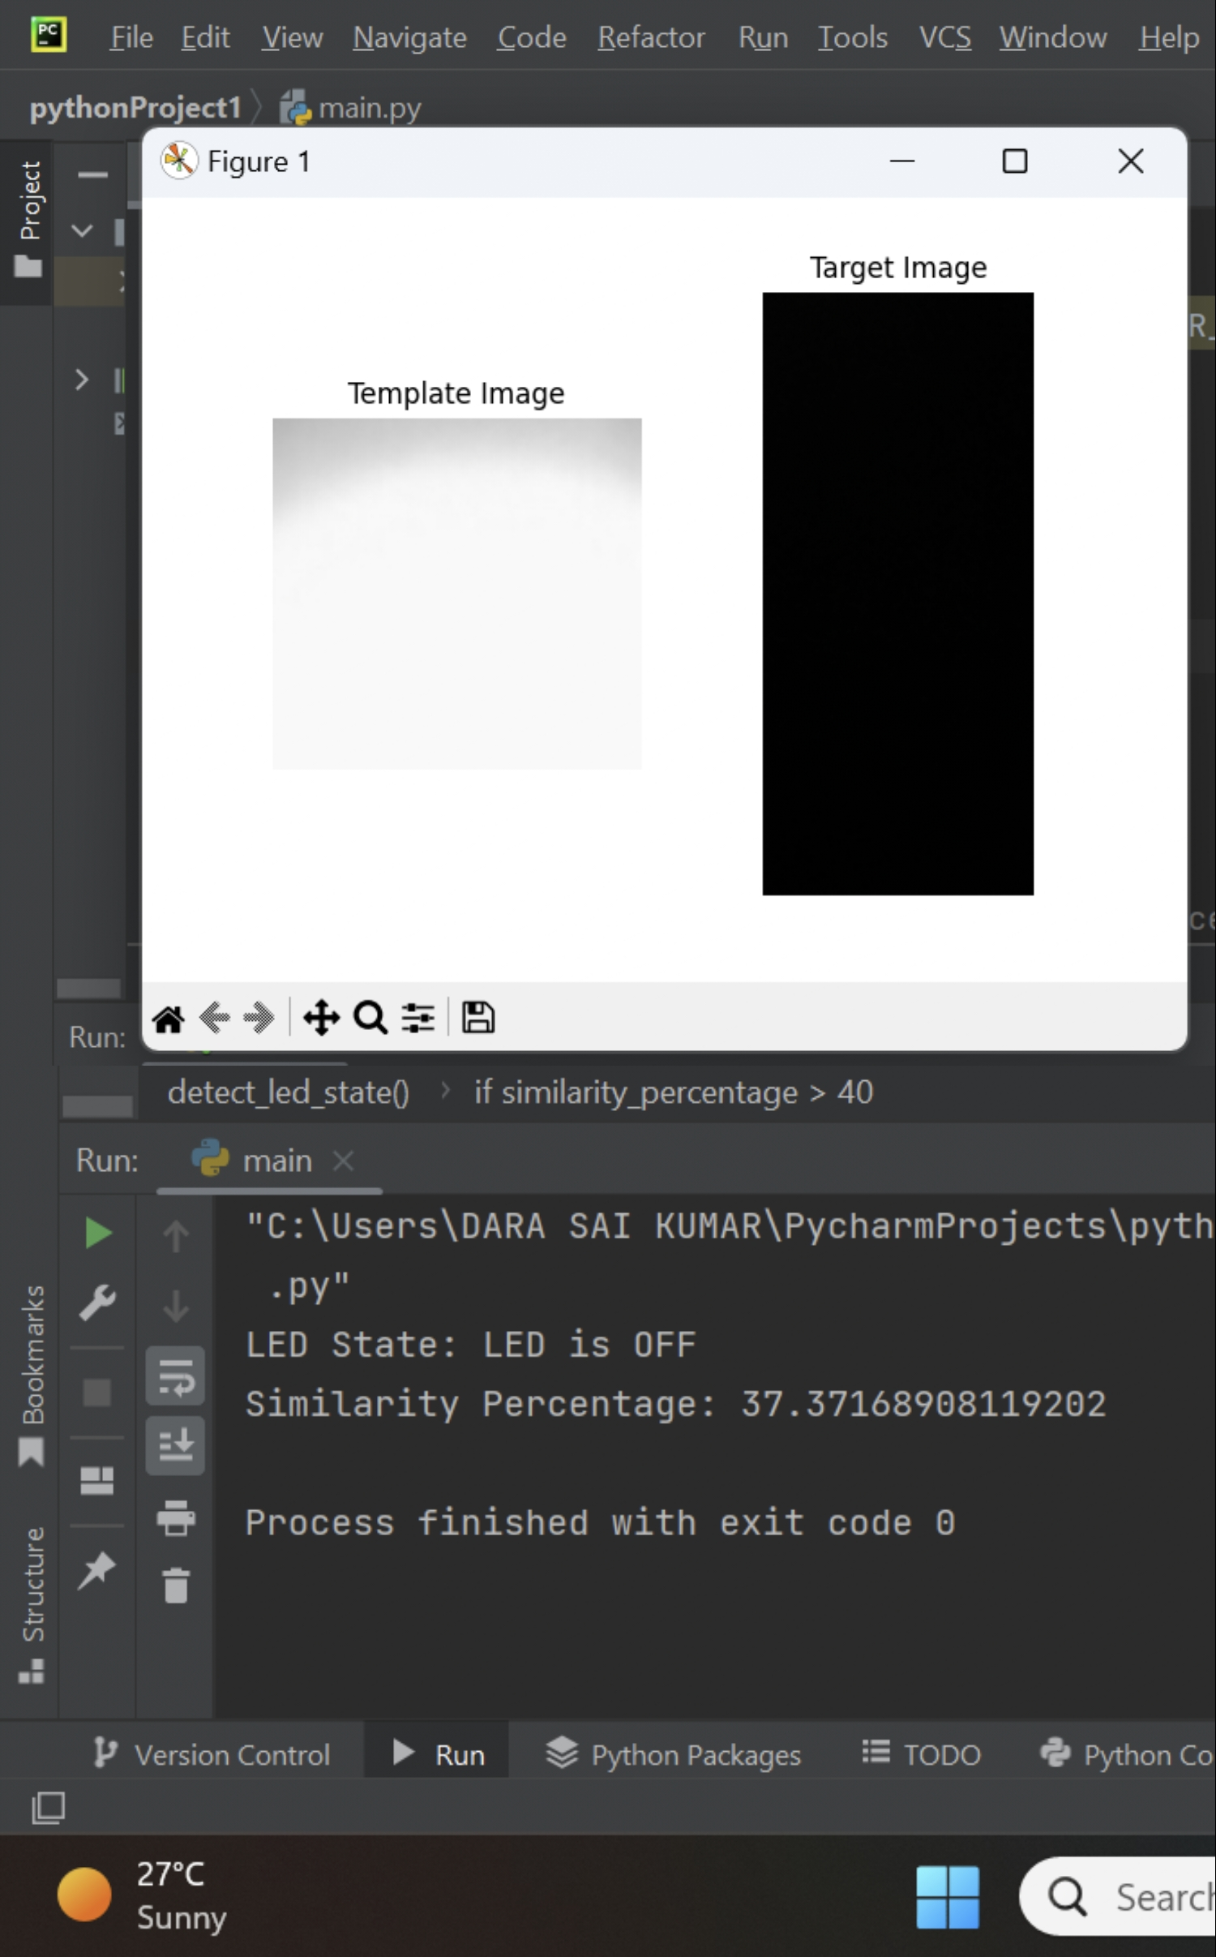
Template Matching
Template matching can produce some good results when we opt for additional image enhancement techniques
Connected Devices and Wearables Lab, IIIT-B
Connected Devices and Wearables Lab, IIIT-B

Slide 10
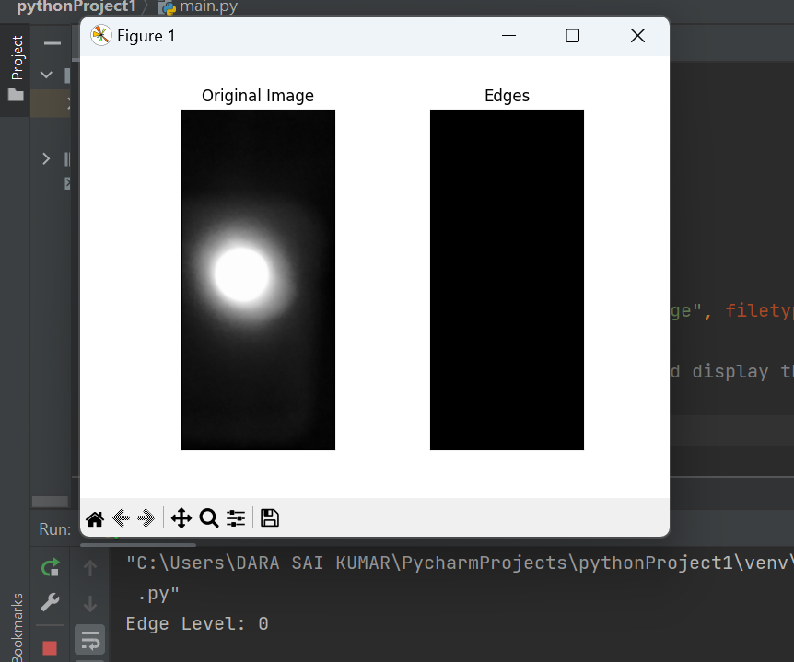
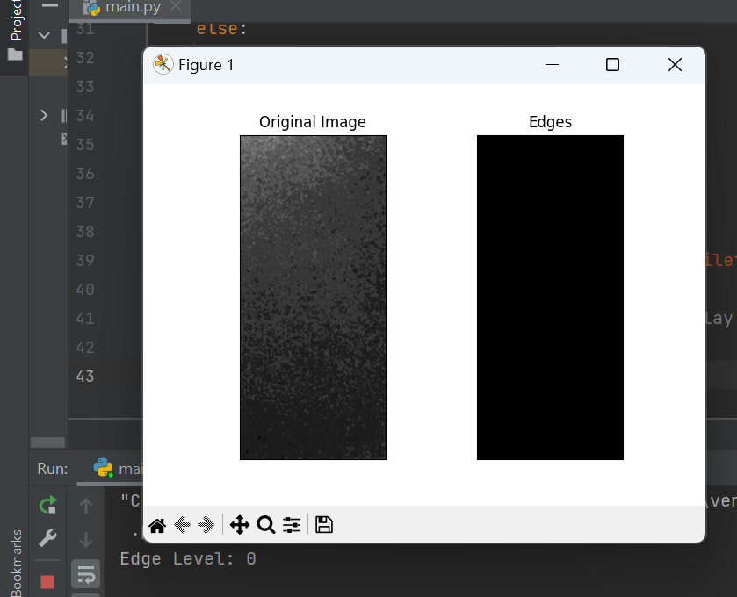
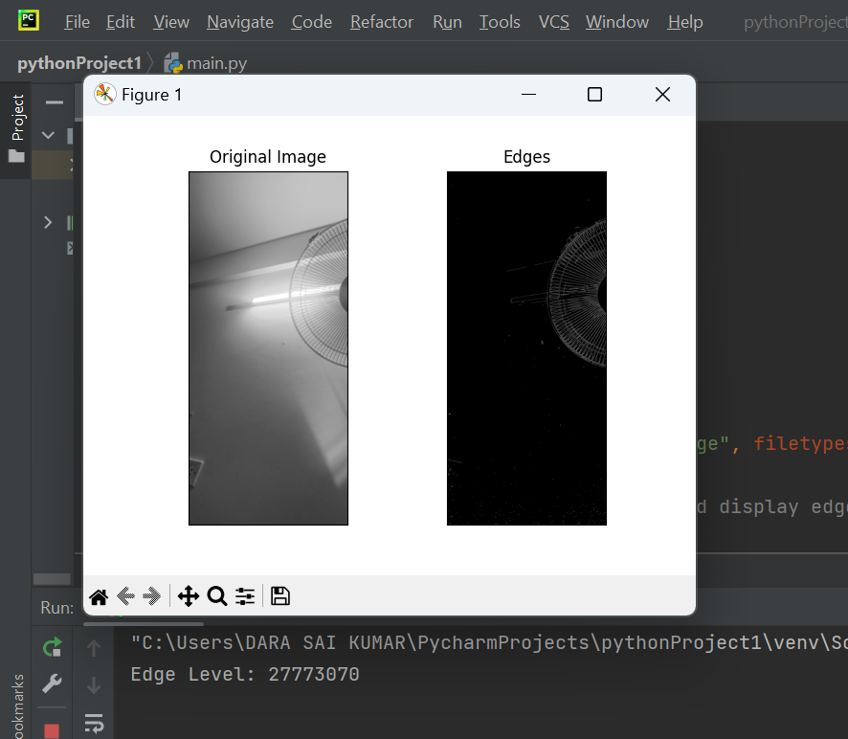
Edge dection using canny filter
Based on the observations edge may not give appropriate/exact results for detecting LED state
Connected Devices and Wearables Lab, IIIT-B
Connected Devices and Wearables Lab, IIIT-B

Slide 11
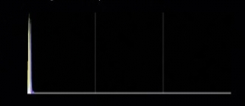
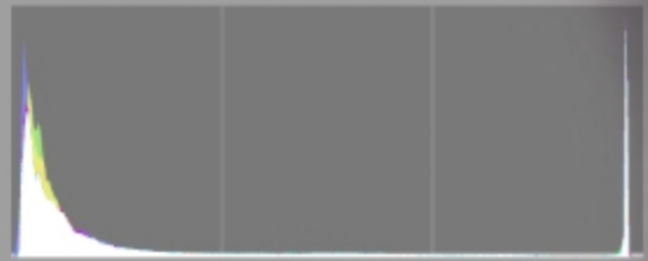
Histogram Analysis
Histogram of an image represents the number of times a particular gray level has occurred in an image.
It is a graph between various gray levels on x-axis and the number of times a gray level has occurred in an image, on y-axis.
Histogram gives insight about the contrast in an image.
It Compare the shapes, peaks, and variations in the histograms of the two images
It tells us the difference between average gray level of an object and that of the surroundings.
Histogram Equalization helps in enhancing the techiniques like Thresholding And Frequency Domain Analysis of An image
It may not be ideal for separation of images
Connected Devices and Wearables Lab, IIIT-B
Connected Devices and Wearables Lab, IIIT-B
Connected Devices and Wearables Lab, IIIT-B
Connected Devices and Wearables Lab, IIIT-B

Slide 12
Introduction
WHY WE ARE MOVING FROM INTENSITY BASED LED DETECTION TO HSV BASED LED DETECTION?
From the experimental Analysis,
when we applied the intensity Based LED Classification using Thresholding is able to distinguish the Led ON /OFF state .
The observations are:
From the intensity based thresholding Algorithm we can able to detect that all the LED OFF condition images have a constant intensity level (73-75 pixels/cm)
There are some LED ON condition images which may lie below that intensity level or above that intensity level.
so, Intensity Based Thresholding may not work in All conditions
WHATS NEXT
Using HSV Based Algorithm ,which can able to detect the color[Green] in the given Image .
If Algorithm able to detect the Color[Green] in the image then find the ROI co-ordinates of the Green color segment in the image .Stating that LED IS ON if ROI is found . If else stating LED is OFF.
Connected Devices and Wearables Lab, IIIT-B

Slide 13
HSV
HSV-Hue Saturation Value
It is based on cylindrical co-ordinate system.
HSV separates the color information (hue), intensity (value), and saturation of an image, making it easier to analyze and manipulate colors.
[Using this model, an object with a certain color can be detected and to reduce the influence of light intensity from the outside
It is just like RGB---- Fundamentally Having ‘3’ components
Hue(H):Nothing but color -Represented in a 360 degree of color circle , covering entire color
spectrum
Saturation (S): corresponds to intensity/purity of color image
Reprensented in terms of percentage (0-100)%
It signifies the intense color presence
Value(V): corresponds to Brightness of the image
Ranges from [0-100] where 0 corresponds to Black and 100 corresponds to Bright .
RGB TO HSV Conversion

Slide 14
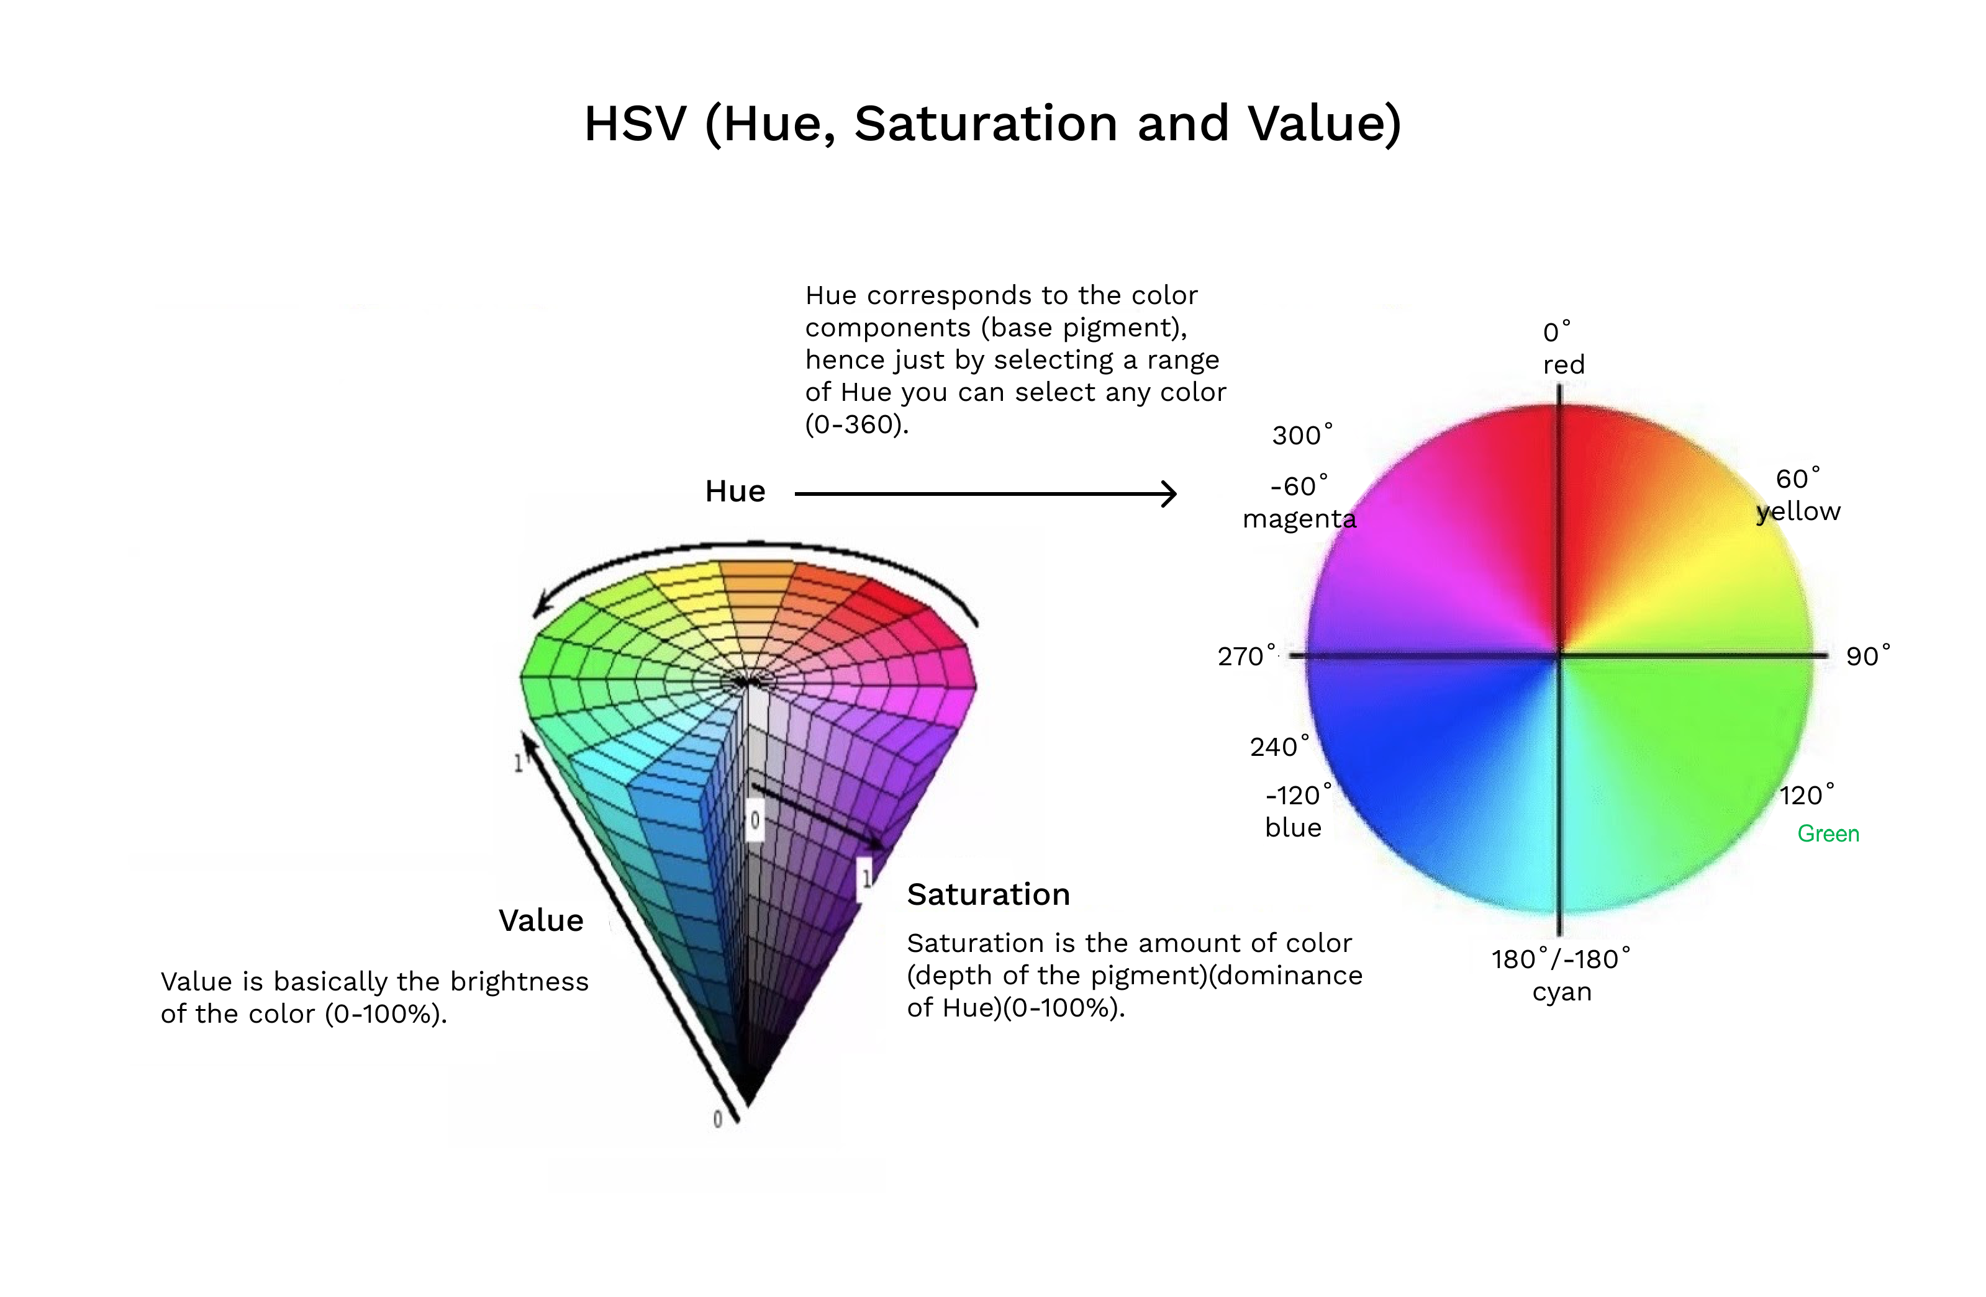
Image Discription

Slide 15
Green colour Segmentation
[The choice of specific values for green color in HSV depend on application specific, can vary depending on the lighting conditions, camera settings, and the specific shade of green you want to detect]
From the above Hue colour chart
Green colour starts from the range of minimum of 60 and maximum of 180
saturation(S) range of approximately 50 to 255 (or 0.2 to 1.0 when normalized) is commonly used to capture vibrant green colors while avoiding desaturated or grayish colors.
The brightness component depends on whether you want to detect bright or dark green colors. For bright green, a value range of approximately 50 to 255 (or 0.2 to 1.0 when normalized) can be suitable. For darker shades of green, a lower value range, such as 0 to 150, might be more appropriate.
lower_green = np.array([60, 50, 50])
upper_green = np.array([80, 255, 255])

Slide 16
Mask
mask = cv2.inRange(hsv_image, lower_green, upper_green)
The cv2.inRange() function expects the input image to be in the HSV color space to perform color range filtering .
lower_green =lower limit of green color that holds in HSV Color space
Upper_green = upper limit of green color that holds in HSV Color space
[These values determine the minimum/maximum acceptable values for each channel in the HSV color space for a pixel to be considered within the green color range]
Mask: says,where each pixel that falls within the specified color range is assigned a value of 255 (white), and pixels outside the range are assigned a value of 0 (black).
[By, applying Mask only green color pixels are considered for further processing Like Finding ROI]

Slide 17
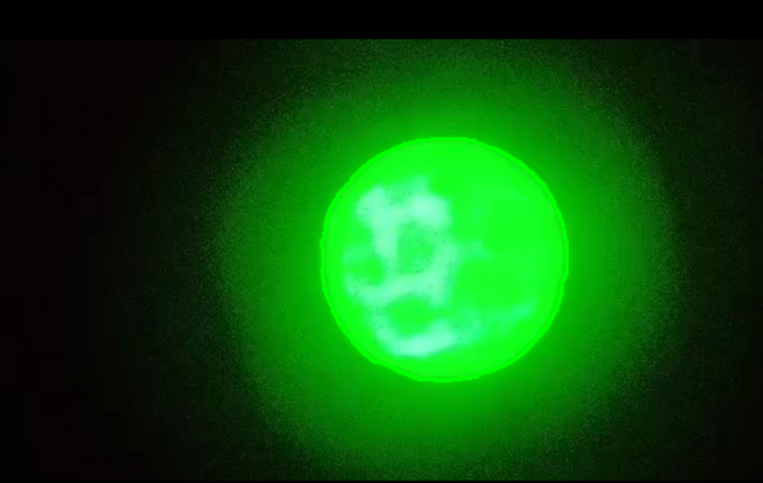
Contour Detection
Contour : defined as a curve that joins set of points enclosing an area having same colour /intensity
This Area of uniform colour/Intensity forms the object that we are trying to detect, and curve enclosing that Area is the contour , representing the shape of the object.
contours, _ = cv2.findContours(mask, cv2.RETR_EXTERNAL, cv2.CHAIN_APPROX_SIMPLE)
We use cv2.findContours function to detect the contours to the Green Colour that we detected in the Image using Mask
Whrere,cv2.RETR_EXTERNAL =mode that detects the all external contours of the intensity/colour
cv2.CHAIN_APPROX_SIMPLE = Approximation method
video Reference [for better concept]

Slide 18
Region of Interest(ROI)
ROI is something like the part/segment at which , we are interested in the entire image
[As using the mask layer to the input HSV image by determining lower and upper green colour we are able to figure out the green colour segment from the image]
ROI part we are looking in the entire image is green colour segment/ green contour
ROI is consize of coordinates W.R.T to Rectangle
ROI= (x,y,w,h) where ,(x,y) are position of co-ordinates
(w,h) are width and hieght of pixels
x, y, w, h = cv2.boundingRect(contour)
A sample CNN Model which is able to detect led on/off state
[The main Idea of extracting green colour in the given image ,based on green colour finding the ROI co-ordinates is found, Based on ROI detecting on/off state of Led ]

Slide 19
CNN Module
-Convolutional Neural Network(CNN)
Convolutional Layers:
The first essential component of a CNN is the Convolutional layer. It consists of filters (also known as kernels), which are small windows that slide over the input image.
The filter's purpose is to detect specific features or patterns in the input image, such as edges, textures, and shapes.
As the filter slides over the input image, it performs element-wise multiplication with the corresponding pixel values and sums up the results.
The result of this convolution operation is stored in a feature map, which represents the presence of certain features in the input image.
Multiple filters are used in a single convolutional layer, resulting in multiple feature maps.
Activation Function:
After the convolution operation, an activation function, such as ReLU (Rectified Linear Unit), is applied element-wise to each element of the feature maps.
ReLU helps introduce non-linearity into the model, allowing the CNN to learn complex patterns and make the network more expressive.

Slide 20
Pooling Layers:
Pooling layers are used to reduce the spatial dimensions of the feature maps while retaining their most important information.
The most common pooling operation is MaxPooling, which takes the maximum value within a small region of the feature map and creates a new down-sampled map.
Pooling helps reduce the computational complexity and the number of parameters in the network, which helps prevent overfitting and makes the model more efficient.
Fully Connected Layers:
After several convolutional and pooling layers, the feature maps are flattened into a 1-dimensional vector.
This vector is then fed into one or more fully connected (Dense) layers, which perform traditional neural network operations.
The fully connected layers learn to combine the features extracted by the previous layers to make the final classification decision.
Output Layer:
The final layer of the CNN is the output layer, which has as many neurons as there are classes in the classification problem.
Typically, a softmax activation function is used in the output layer for multi-class classification, as it converts the model's raw output into probability scores for each class.
The class with the highest probability is then selected as the predicted class.

Slide 21
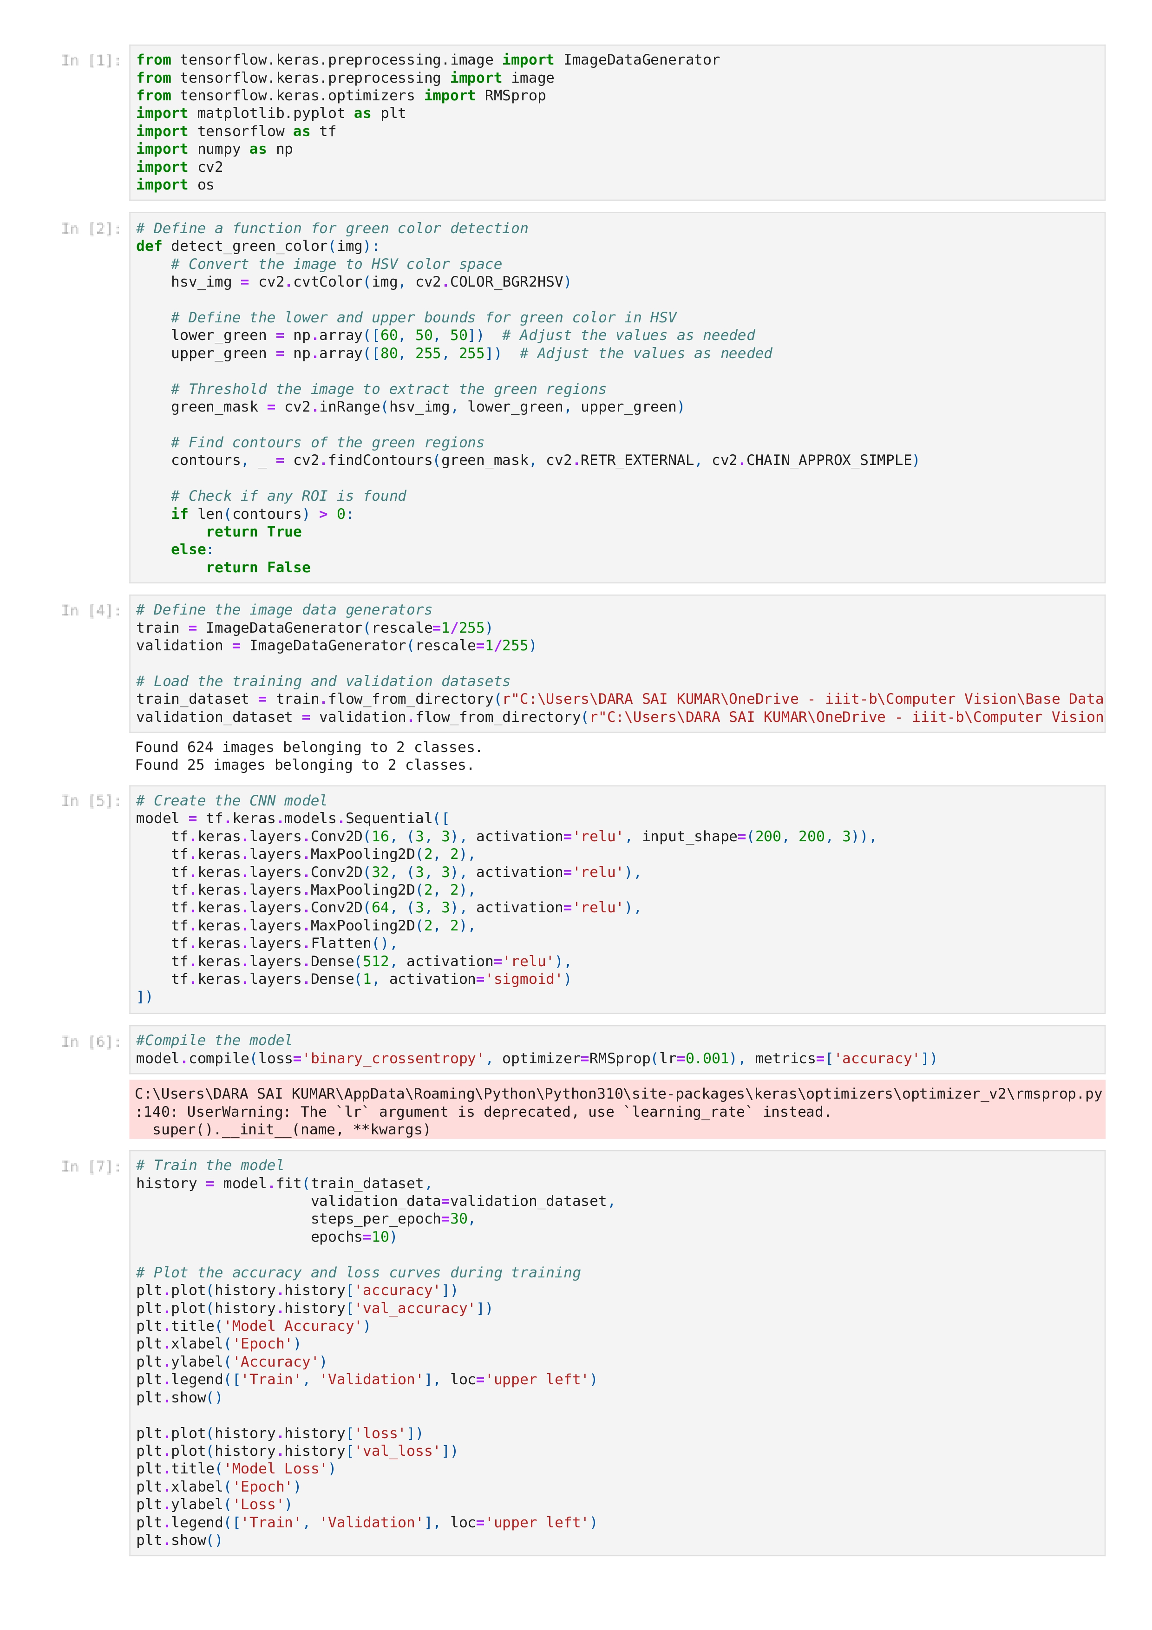
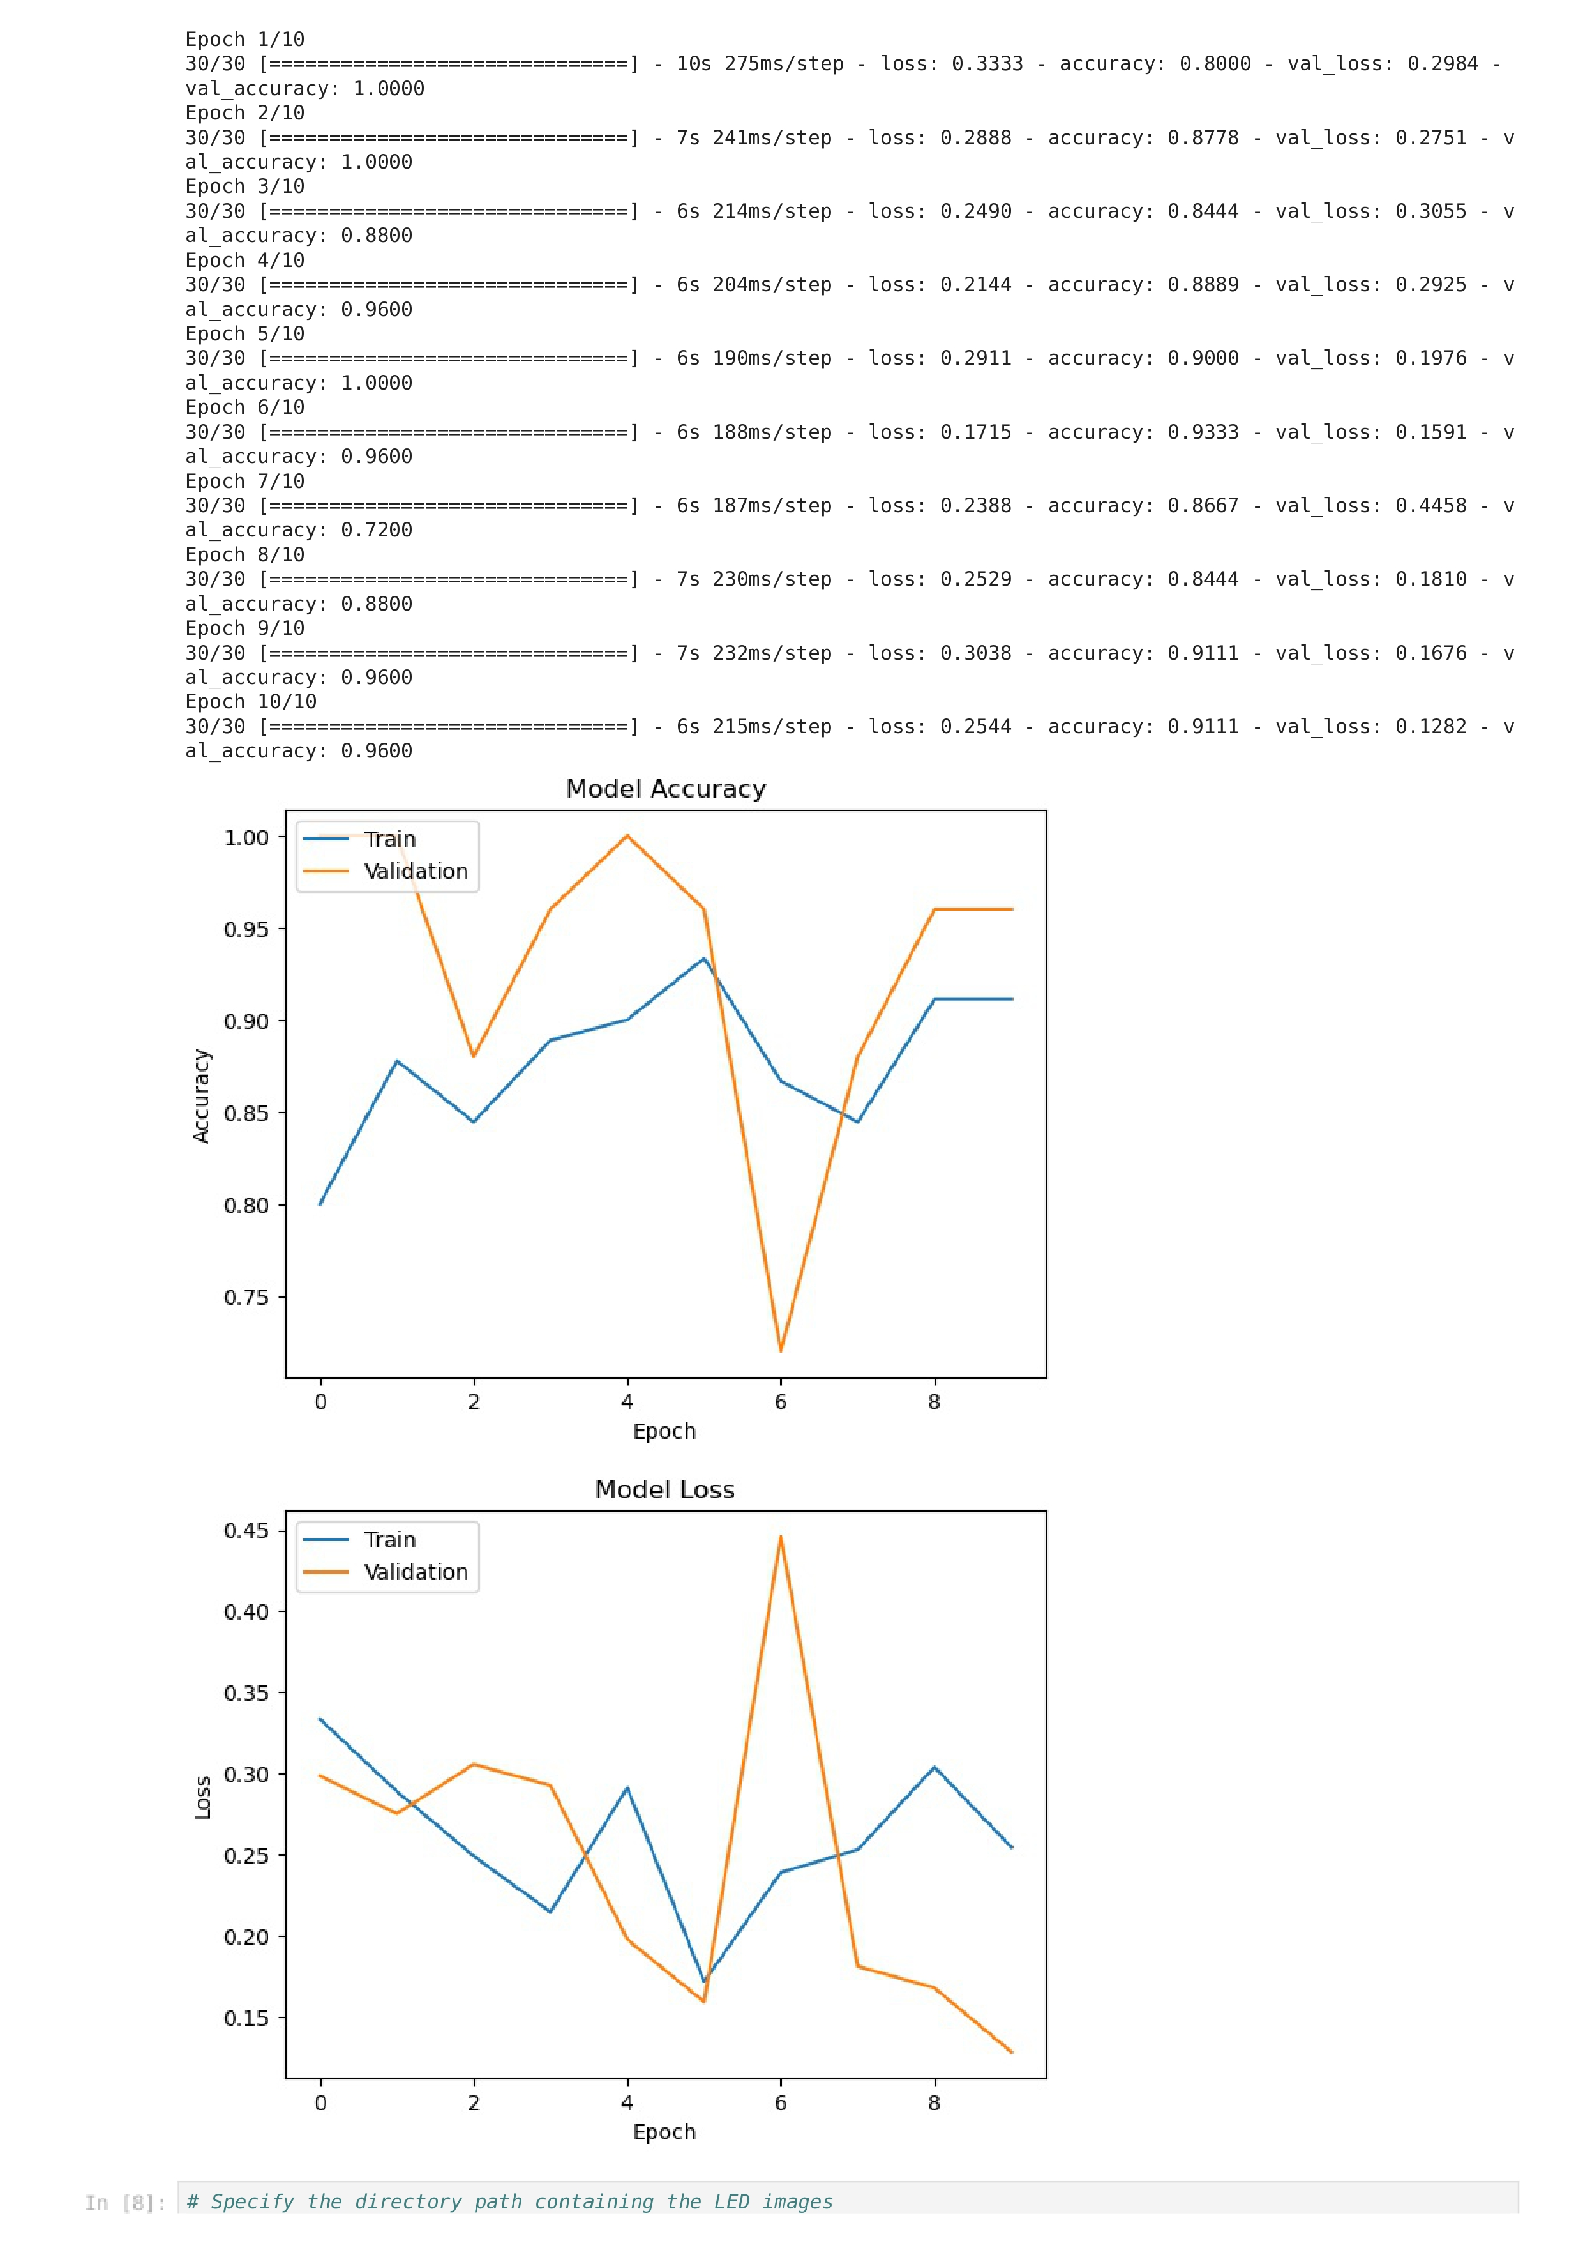
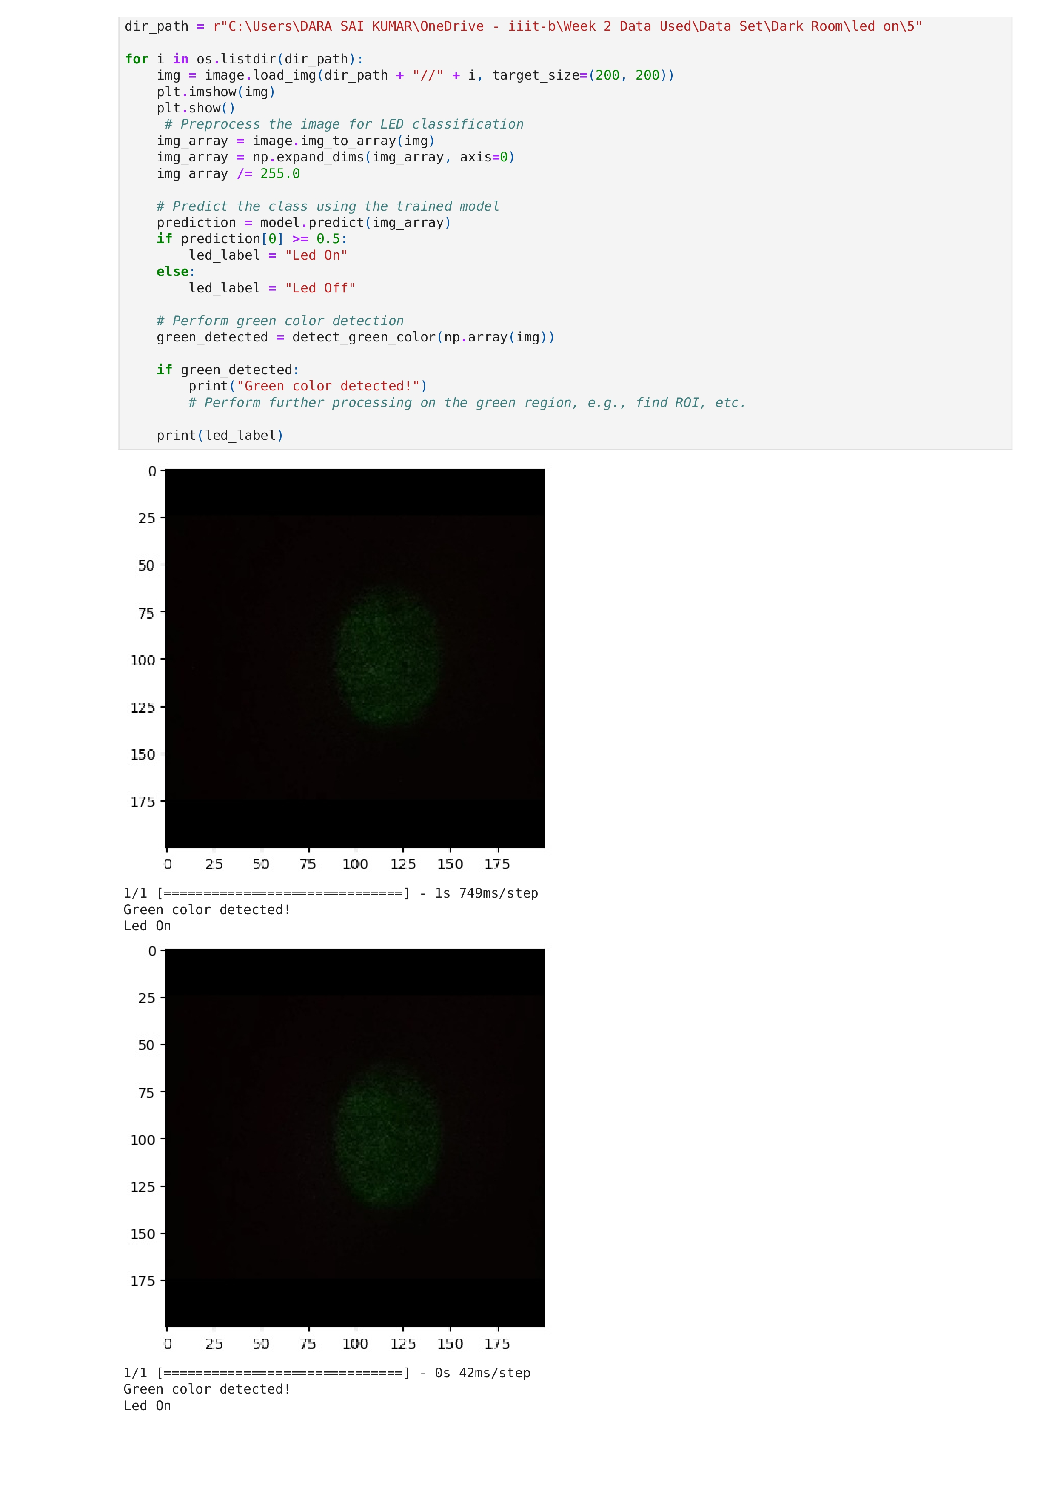
CNN

Slide 22
CNN MODULE
Youtube References for better understanding:
1.https://youtu.be/J1jhfAw5Uvo
2. https://youtu.be/VF4BDE7uqY0
CNN Module Buliding Refernce Tutorial –Link
CNN Module for Image Classification Task --------------Link
[ CNN Module has Given some better results based on the task performed .It is able to differentiate the LED ON/OFF state from the Intensity Level of 5. In both Dark Room and Light Room setup. And able to produce accuracy upto 95% .Accuracy of Model can be improved by using large Amount of Training Data SET.]
DATA SETS LINKS:
CNN Module Code: https://iiitbac-my.sharepoint.com/:b:/g/personal/srip2023057_iiitb_ac_in/EU-SC0y8hSFDi77GMVk79UQBsykZmneaoZLpZSCPurOPAQ
CNN Module Data Set: https://iiitbac-my.sharepoint.com/:f:/g/personal/srip2023057_iiitb_ac_in/EpPmoYUoOJBJr1wW7OpODUEBr0lM8ASeXjjFxxt3xjYhogCNN Module Testing Data set : https://iiitbac-my.sharepoint.com/:f:/g/personal/srip2023057_iiitb_ac_in/ErJTHiqkNnRGvkQp-pKaDdIBnHs8eiTR62ewCJolUGXP9g

Slide 23
Auto-ML Packages for image Classification
Connected Devices and Wearables Lab, IIIT-B

Slide 24
Introduction
What Is the Progress Till Now
We,had gone through Various different methods to classify given image data to ON/OFF
In this process we have gone through various methods like Thresholding ,Histogram Analysis ,Edge Detection and machine Learning Algorithms –PPT
Finally ,We are Working on the Detection Of Green Colour From image we concluded that HSV based Image Classification Comes Very Handy
Here is the CNN Module Which can obtain Accurate results From intensity level of 5 .Both in the conditions of Dark Room and Light Room.
What’s NEXT?
Finding Best Auto-ML Package for doing the image classification task Automatically Using Different Models
Connected Devices and Wearables Lab, IIIT-B
Connected Devices and Wearables Lab, IIIT-B

Slide 25
Auto –ML Packages
There are many Auto-ML Packages that are available for doing the task
here are some modules which can be used for our task
1.Auto-Keras
2.Google Cloud Auto-ML
3.Microsoft Azure Auto-ML
4.H20.ai
5.Ludwig

Slide 26
Autokeras
Accessibility: AutoKeras is freely accessible and open-source.
Features: AutoKeras supports various image processing tasks, including image classification, object detection, and image regression. It provides an easy-to-use API and automates the process of model architecture search and hyperparameter tuning.
Learning Resources: You can learn about AutoKeras in detail from its official documentation (https://autokeras.com/) and GitHub repository.
Pros: User-friendly, open-source, supports multiple image processing tasks.
Cons: Limited flexibility compared to manually designing models.

Slide 27
Google Cloud Auto-ML
Accessibility: Google Cloud AutoML is a cloud-based platform that offers both free and paid options.
Features: AutoML Vision, provided by Google Cloud AutoML, supports image classification, object detection, and image segmentation tasks. It offers powerful pre-trained models and allows customization for specific use cases.
Learning Resources: You can find detailed information about Google Cloud AutoML on the official Google Cloud AutoML documentation (https://cloud.google.com/automl) and tutorials.
Pros: Powerful and customizable, integrates well with Google Cloud ecosystem.
Cons: Cloud-based platform, paid options for certain features.

Slide 28
Microsoft Azure AutoML
Accessibility: Microsoft Azure AutoML is a cloud-based platform that offers both free and paid options.
Features: Azure AutoML provides image classification and object detection capabilities. It offers pre-trained models and enables customization and transfer learning.
Learning Resources: Microsoft provides comprehensive documentation, tutorials, and examples on the Azure AutoML website (https://azure.microsoft.com/en-us/services/automl/).
Pros: Integration with Azure ecosystem, customization options.
Cons: Cloud-based platform, paid options for certain features.
Connected Devices and Wearables Lab, IIIT-B

Slide 29
AutoKeras
Is a ML (ML) automation framework based on Keras, a widely known neural network library based on TensorFlow,which provides high-level building blocks for developing DL models.
It uses Deep Learning (DL) ,which is a subset of Machine Learning which is used to extract patterns from the data by implementing Successive layers that are responsible for extracting relevant features. It is a multistage learning patterns from the data .
AutoKeras is an open source AutoML framework that allows a non-ML expert to create high-performance models in a simple way.
Even we have many other Auto-ML cloud platforms like (Google,Microsoft,Amazon,IBM).Many of them are not freely accessible. But Autokeras is an AutoML system based on Keras open source developed by Data Lab at Texas A&M university .
Connected Devices and Wearables Lab, IIIT-B

Slide 30
Why Autokeras:
It has a clear and intuitive application programming interface (API) based on the
Keras API. Users without programming experience can easily learn how to use it,
but it also allows advanced users to adjust lower-level system parameters.
• It can work both locally and in the cloud.
• It is based on a dynamic configuration that adapts the size of the neural architecture
in the function of the graphics processing unit (GPU) memory available on the
local system.
• It is actively developed and maintained by the open-source community.
Connected Devices and Wearables Lab, IIIT-B

Slide 31
Automating the Machine Learning
Automating the machine learning pipeline involves automating a series of processes such as data exploration, data preprocessing, feature engineering, algorithm selection,model training, and hyperparameter tuning.
The digit images were stored in NumPy matrices, also called tensors.
These tensors are the basic data structures for machine learning models.
TENSOR
A tensor is basically a multi-dimensional array of numbers, usually floating-point numbers of N dimensions
A tensor is defined by three key attributes:
Rank (axes number): This is also called a dimension in numpy nomenclature (ndim).
Shape (each axis dimension): This is the dimension of each axis and returns a tuple with the lengths of the corresponding array dimensions
Data type: The type of data that's contained in the tensor is usually floating-point
numbers because the computer works in a more optimal way with this type of data.
Connected Devices and Wearables Lab, IIIT-B

Slide 32
Data Preprocessing operations for Neural Network Models:
Feature engineering: This is the process of extracting features from raw data using the domain knowledge of human experts, in such a way that these extracted features improve the performance of our models.
Data normalization: Neural networks work much better with small input values,usually between 0 and 1. It is easier for the model to learn from small numbers because the learning algorithms are based on gradient updates being made to itsweight parameters, in such a way that small values will cause faster updates.
Data vectorization:neural networks work with tensors.Each source that feeds your model, such as texts, images, or sounds, must be converted into a tensor through a process called vectorization.
Missing values processing:Datasets often contain missing values in some records, deep
learning models, initializing missing values to 0 is a common practice, as long as 0 is
not already a significant value. Once the neural network model learns that 0 means
a missing value, it will ignore it every time.
Connected Devices and Wearables Lab, IIIT-B

Slide 33
Image Classification with Autokeras
Autokeras uses deep neural networks to perform image classification. It automatically selects the best architecture and set of hyperparameters using a Bayesian optimization algorithm, which improves the accuracy of the resulting models.
Prediction and Evaluation
Neural Architecture Search (NAS)
The trained model is used to predict labels for new, unseen data, and its performance is evaluated using various metrics, including accuracy, precision, recall, and F1-score.
Autokeras performs automated NAS to search for the best architecture for a given dataset.
1
2
3
4
Data Preprocessing
Model Training and Validation
The input data is preprocessed, including normalization and data augmentation, which enhances the accuracy of the model and prevents overfitting.
The selected model is trained on the data and validated using a separate dataset to measure its accuracy.
Connected Devices and Wearables Lab, IIIT-B

Slide 34
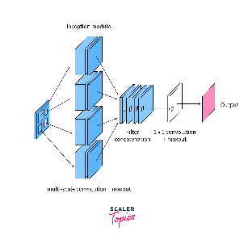
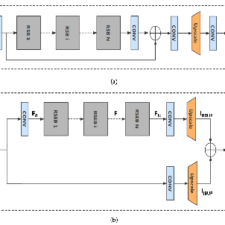
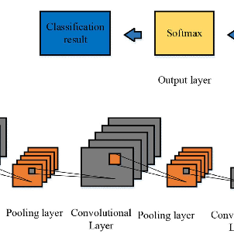
ML Algorithms Used by Autokeras for Image Classification
Autokeras uses various ML algorithms, such as Convolutional Neural Networks (CNNs), Residual Networks (ResNets), and Inception Networks, to perform image classification. It selects the best algorithm for a given task using Bayesian optimization.
Convolutional Neural Networks (CNNs)
Residual Networks (ResNets)
Inception Networks
ResNets use skip connections to link earlier layers to later ones, allowing the network to learn more efficiently and prevent the vanishing gradient problem.
Inception Networks use multiple convolutional filters of varying sizes to capture features at different scales, improving the accuracy of the model.
CNNs are commonly used for image classification tasks. They consist of multiple convolutional and pooling layers that learn to detect various features of the input image.

Slide 35
How Autokeras Selects the Best Algorithm for image classification
Autokeras uses Bayesian optimization to select the best ML algorithm for a given image classification task. It iteratively evaluates the performance of various algorithms on a subset of the dataset and updates its model accordingly.
2
3
Model Selection
1
Bayesian Optimization
Surrogate Functions
Autokeras uses a probabilistic model to predict the performance of various ML algorithms, given their hyperparameters and the available dataset.
Autokeras uses surrogate functions to approximate the performance of each algorithm on the entire dataset, given its performance on the subset.
Autokeras selects the best algorithm based on the predicted performance and ranks them accordingly.

Slide 36
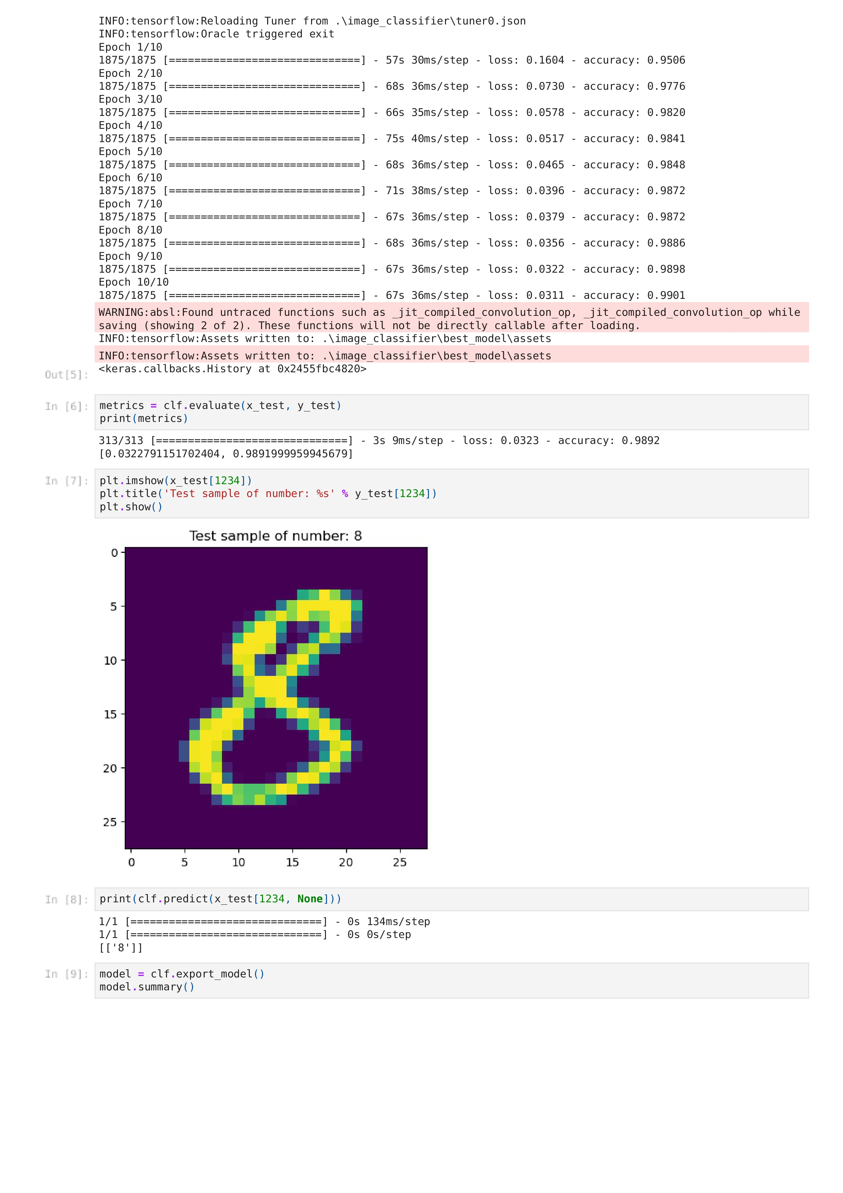
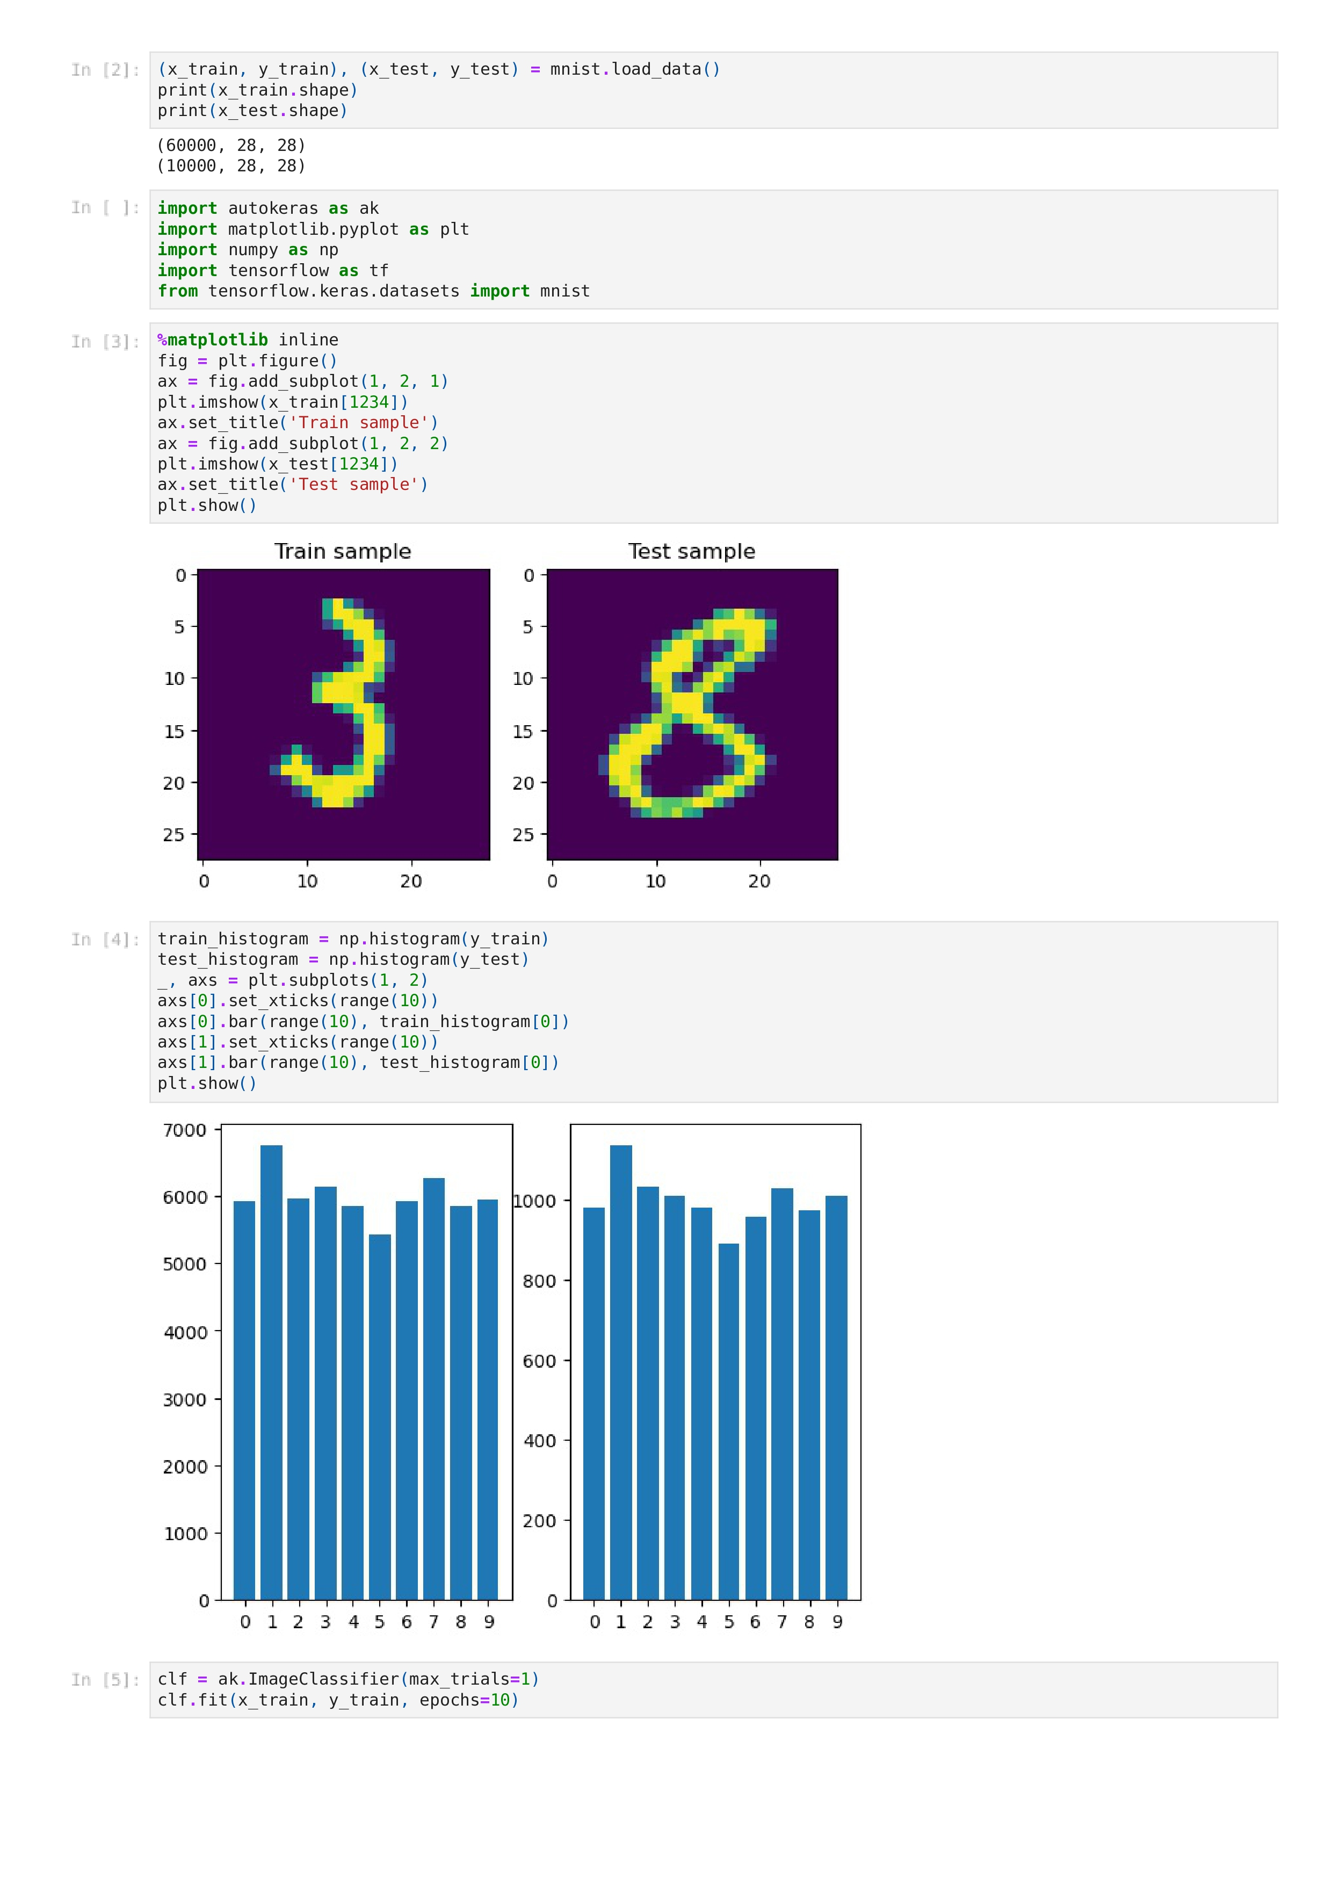
Sample Auto Keras

Slide 37
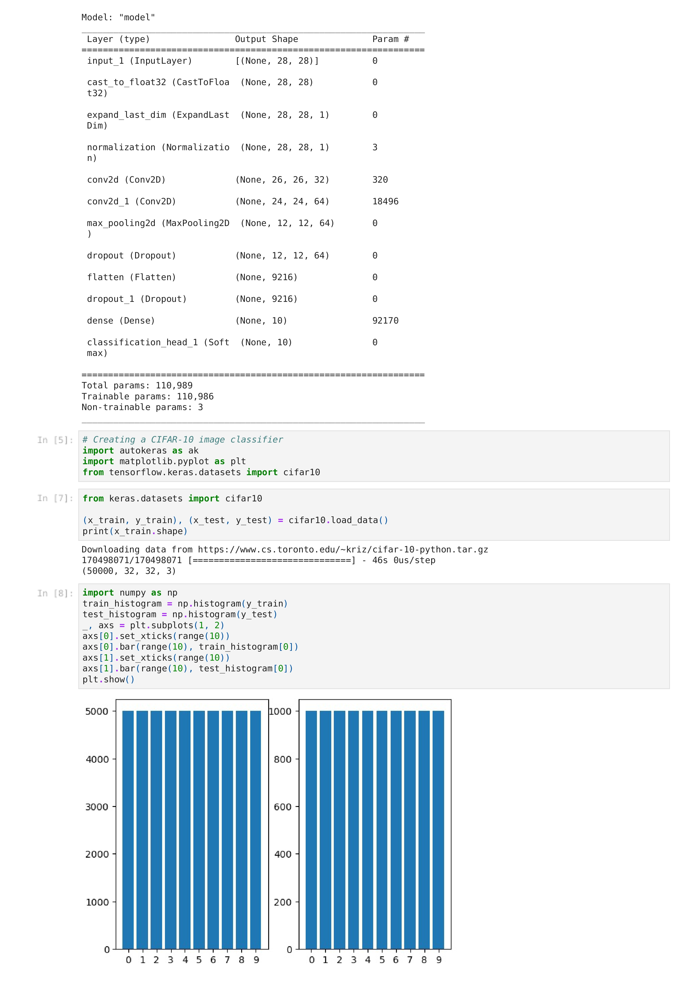
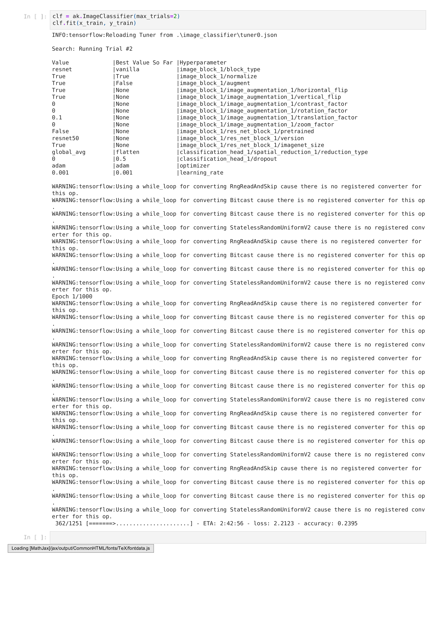
Sample AutoKeras

Slide 38
Sample Autokeras
-sample Autokeras Implementation in google colab - Autokeras.
- EXPLANATION for the code implemented in google colab.
Book That I followed for understanding of Autokeras-Link
OBSERVATION :
1.For Implementation of Any Autokeras code either on Jupyter notebook or Google colab it must have well defined dataset and Model . Since they require significant computational resources, including memory and time, to search for the best models and hyperparameters.
2. Main Challenges:
Resource Limitations: Colab provides limited computational resources, and running Autokeras on large datasets or complex tasks may be slow or restricted.
Session Timeout: Colab notebooks have a session timeout, which means long-running tasks might get interrupted.
Disk Space: Colab offers limited disk space, and large datasets might not fit in memory, leading to out-of-memory errors.
3. so, using the CNN and KERAS modules for Small set of datasets and particularly image classification task comes into Handy-CNN Module-Link

Slide 39
AUTO-SKLEARN
https://automl.github.io/auto-sklearn/master/
Auto-Sklearn is an Automated Machine Learning (AutoML) toolkit that aims to simplify and automate the process of model selection, hyperparameter tuning, and ensembling. It is built on top of scikit-learn, a popular machine learning library in Python. Auto-Sklearn uses Bayesian optimization, meta-learning, and ensemble construction to find the best model and hyperparameters for a given task.
1. Functioning of Auto-Sklearn:
Auto-Sklearn automates the model selection and hyperparameter optimization process by performing the following steps:
Data Preprocessing: Auto-Sklearn handles data preprocessing steps such as one-hot encoding, data scaling, and handling missing values.
Algorithm Selection: It chooses from a pool of machine learning algorithms, including SVM, random forests, gradient boosting, k-nearest neighbors, etc.
Hyperparameter Optimization: Auto-Sklearn uses Bayesian optimization to efficiently search for the best hyperparameters for each selected algorithm.
Ensemble Construction: The final step involves creating an ensemble of the best-performing models to improve predictive performance.
2. Model Implementation:
Auto-Sklearn provides a scikit-learn compatible API, making it easy to use and integrate into existing workflows. You can use it with familiar scikit-learn functions like ‘fit’, ‘predict’, and ‘score’.

Slide 40
Auto-sklearn
-AUTO SKLEARN in Google colab- link
-Auto Sklearn Do not work on jupyter notebook on Windows.
Observation: auto-sklearn runs on the linux based Environment. 1.Google Colab kernal goes to sleep/interrupt when the Run time of the code is high (even if it exceeds 3 mins).It is major issue when working with the free version , the issue has been encountored when working with the Auto-keras too.
Research Paper Which Interpret the Many Auto-ML Packages and there Performances . LINK
ThankYou

Slide 41
CONCLUSION
Detection of LED state is very important in Li-Fi Data Transmission .In order to Decode the data from the Image .
There are various methods to detect ON/OFF state of LED State from the image
Thresholding , Edge Detection , Histogram Analysis Comes into Handy in dealing with the detection of LED state from the Image.
It is better to work With the particular Color of Image .Such that We are able to use HSV Based Algorithm in order to obtain better Analysis on detection of LED state from the Image.
Contour Detection is very Important In Image Analysis in Detection of LED ON state . It plays a very crucial role ,as It is used for the Accurate Results.
ROI Co-ordinates finding Will Leads us to Detect/Predict the state of LED state In Very Accurate .
Even, Before Moving to the Machine Learning Modules it is better to with the CNN Module , as it alloys the user to Interpret the Model Functioning In a Manual Way by defining our own Parameters based on our requirements.
But ,It is very Important To Work with the Auto ML Packages to interpret the model performance .If the Auto-ML Packages comes into handy will make our Work much more useful.

Slide 42
REFERENCES
[1] S. Singh, V. Verma, A. Sharma, and V. Kaushik, "Threshold-based LED State Detection for Visible Light Communication," 2020 7th International Conference on Signal Processing and Integrated Networks (SPIN), 2020, pp. 380-384
[2]R. C. Gonzalez and R. E. Woods, "Digital Image Processing," 4th Edition, Pearson, 2018.
[3] Y. -y. Zheng, J. -l. Rao and L. Wu, "Edge detection methods in digital image processing," 2010 5th International Conference on Computer Science & Education, Hefei, China, 2010, pp. 471-473, doi: 10.1109/ICCSE.2010.5593576.
[4] G. M. H. Amer and A. M. Abushaala, "Edge detection methods," 2015 2nd World Symposium on Web Applications and Networking (WSWAN), Sousse, Tunisia, 2015, pp. 1-7, doi: 10.1109/WSWAN.2015.7210349
[5] N. Hassan, K. W. Ming and C. K. Wah, "A Comparative Study on HSV-based and Deep Learning-based Object Detection Algorithms for Pedestrian Traffic Light Signal Recognition," 2020 3rd International Conference on Intelligent Autonomous Systems (ICoIAS), Singapore, 2020, pp. 71-76, doi: 10.1109/ICoIAS49312.2020.9081854.
[6]https://www.researchgate.net/publication/354721903_A_Comparison_of_AutoML_Tools_for_Machine_Learning_Deep_Learning_and_XGBoost

Slide 43
THANK YOU

